Slide 1
Particles of the Standard Model
Notes:
There’s a nice interactive display of the fundamental particles at https://www.symmetrymagazine.org/standard-model/

Slide 2

Notes:
https://youtu.be/ehHoOYqAT_U

Slide 3
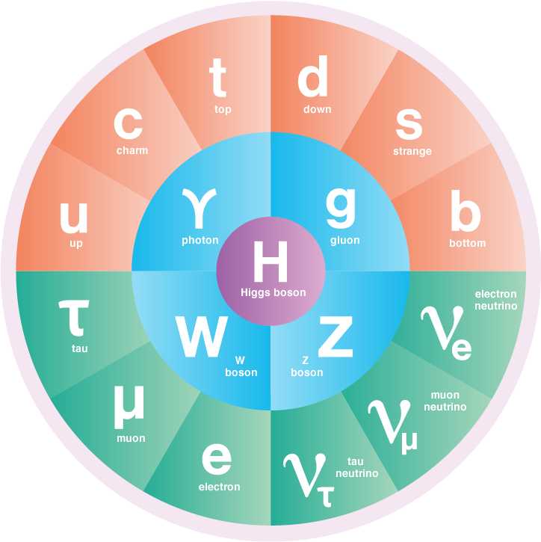
Classifying Particles
Physicists are aware of 17 fundamental particles, which can interact and combine to form a wide range of subatomic particles – a collection so vast that it is sometimes called the ‘particle zoo’.
These particles are organised into a number of overlapping categories and subcategories based on their compositions and properties.
One of these properties is a particle’s intrinsic angular momentum, known more commonly as spin.
Spin is always an integer multiple of ½, and can be positive or negative.
Note that these particles are not literally spinning – spin is just a name for a property they have, like charge.
Notes:
There are ~150 particles in the ‘zoo’, but we only interact with a handful of them in everyday life.

Slide 4

Notes:
https://youtu.be/sB1EPGmpzyg (note that the full video goes waaay beyond what you need to know!)

Slide 5
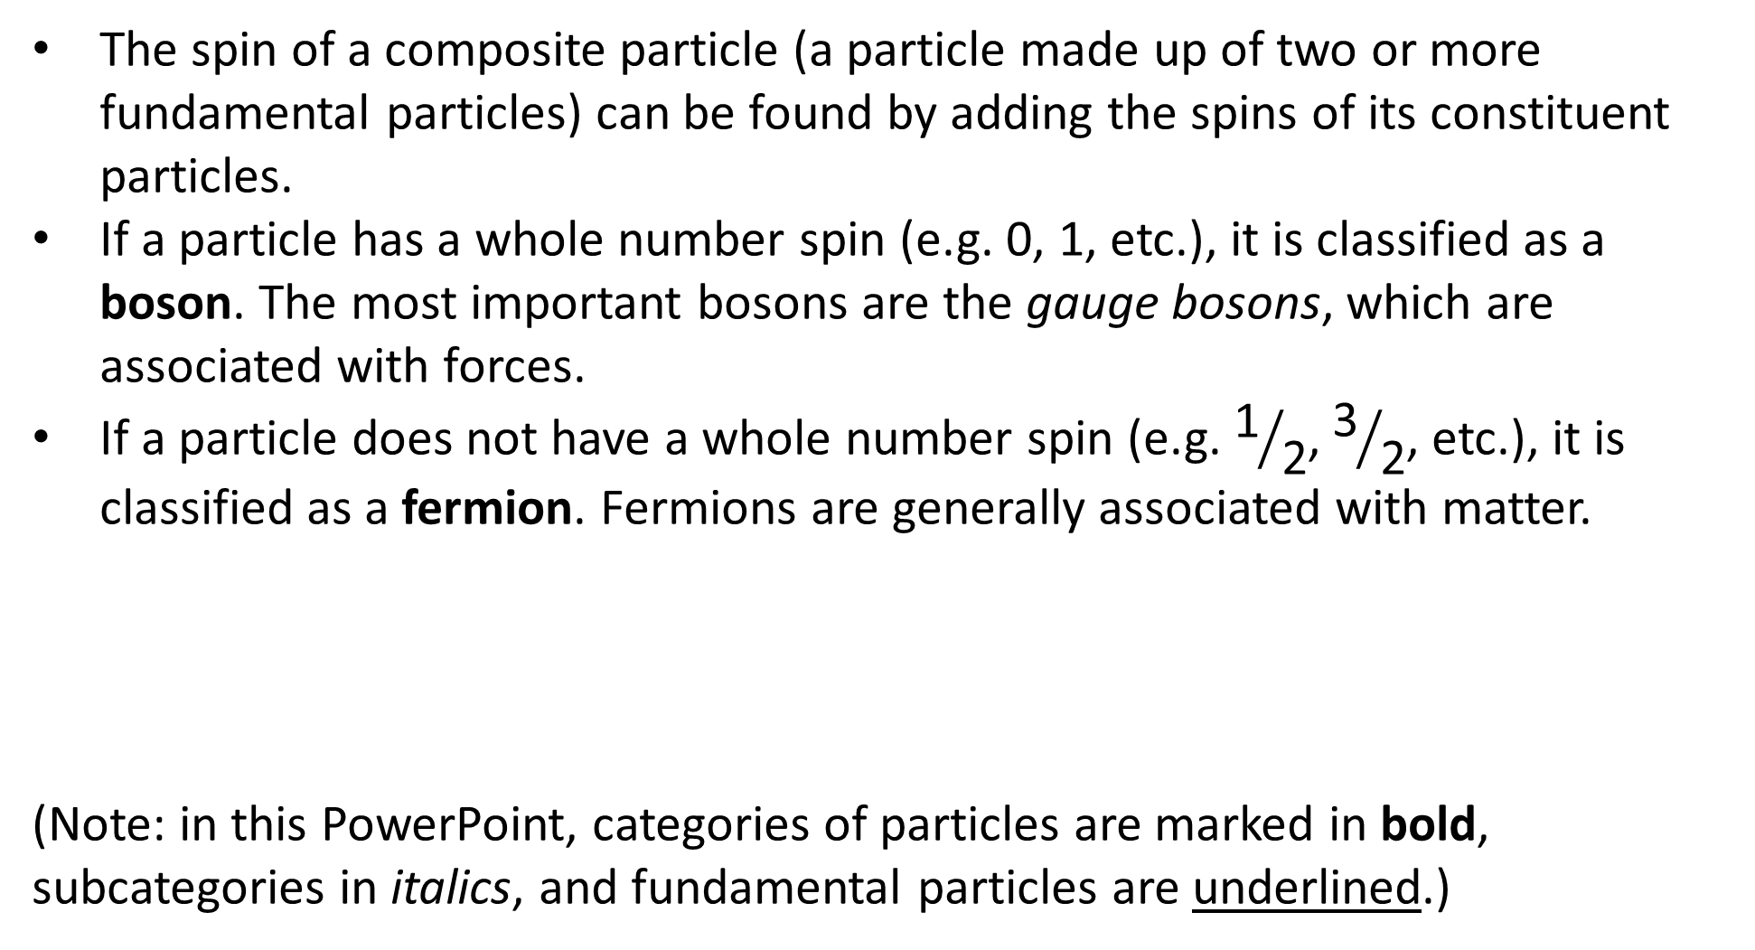
Particle Families: Bosons and Fermions
The spin of a composite particle (a particle made up of two or more fundamental particles) can be found by adding the spins of its constituent particles.
If a particle has a whole number spin (e.g. 0, 1, etc.), it is classified as a boson. The most important bosons are the gauge bosons, which are associated with forces.
If a particle does not have a whole number spin (e.g. ${\text{1}}/{\text{2}}$, ${\text{3}}/{\text{2}}$, etc.), it is classified as a fermion. Fermions are generally associated with matter.
(Note: in this PowerPoint, categories of particles are marked in bold, subcategories in italics, and fundamental particles are underlined.)
Notes:
A number of otherwise helpful YouTube videos imply (or even state!) that all bosons are force carriers, but this is not the case.

Slide 6
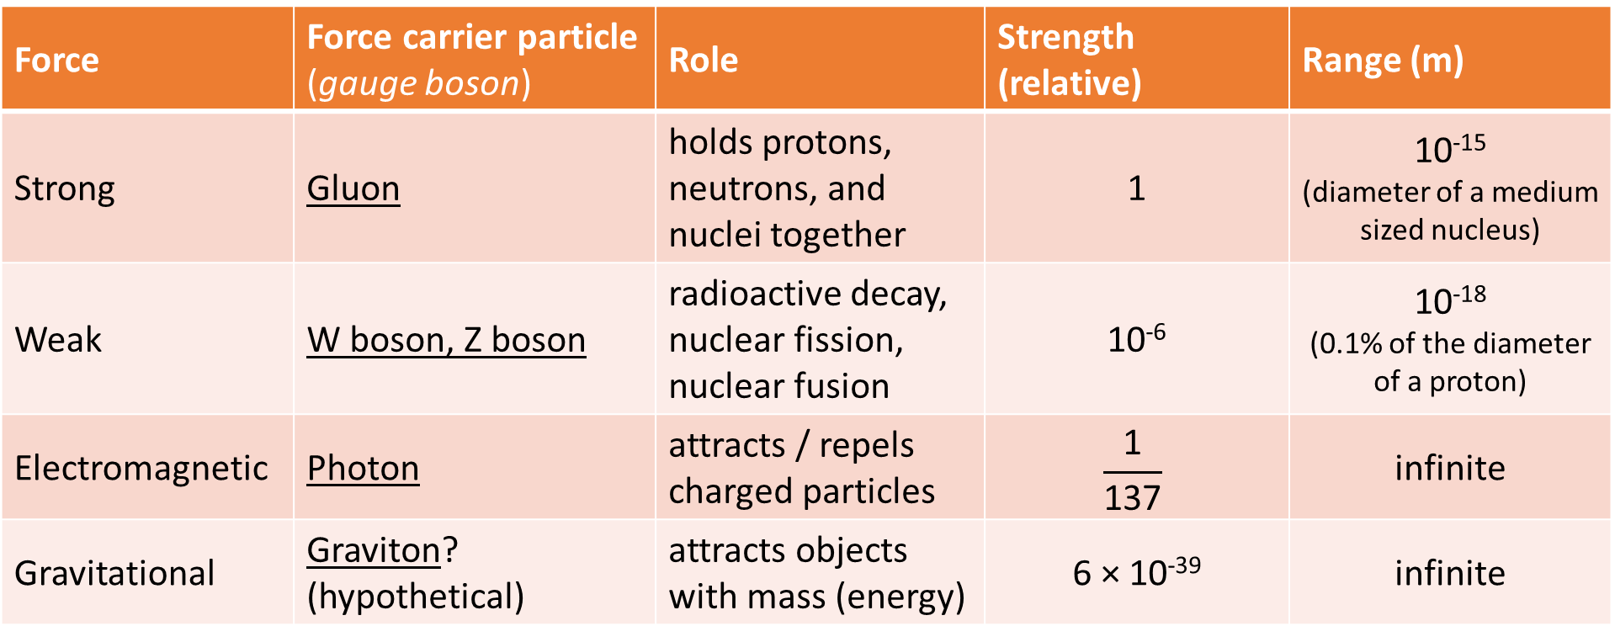
Fundamental Forces
Particles can be further classified based on the forces they are affected by. There are four fundamental forces; each one involves the exchange of a different type (or types) of boson.
Force | Force carrier particle (gauge boson) | Role | Strength (relative) | Range (m)
Strong | Gluon | holds protons, neutrons, and nuclei together | 1 | 10⁻¹⁵ (diameter of a medium sized nucleus)
Weak | W boson, Z boson | radioactive decay, nuclear fission, nuclear fusion | 10⁻⁶ | 10⁻¹⁸ (0.1% of the diameter of a proton)
Electromagnetic | Photon | attracts / repels charged particles | $$\frac{\text{1}}{\text{137}}$$ | infinite
Gravitational | Graviton? (hypothetical) | attracts objects with mass (energy) | 6 × 10⁻³⁹ | infinite

Slide 7
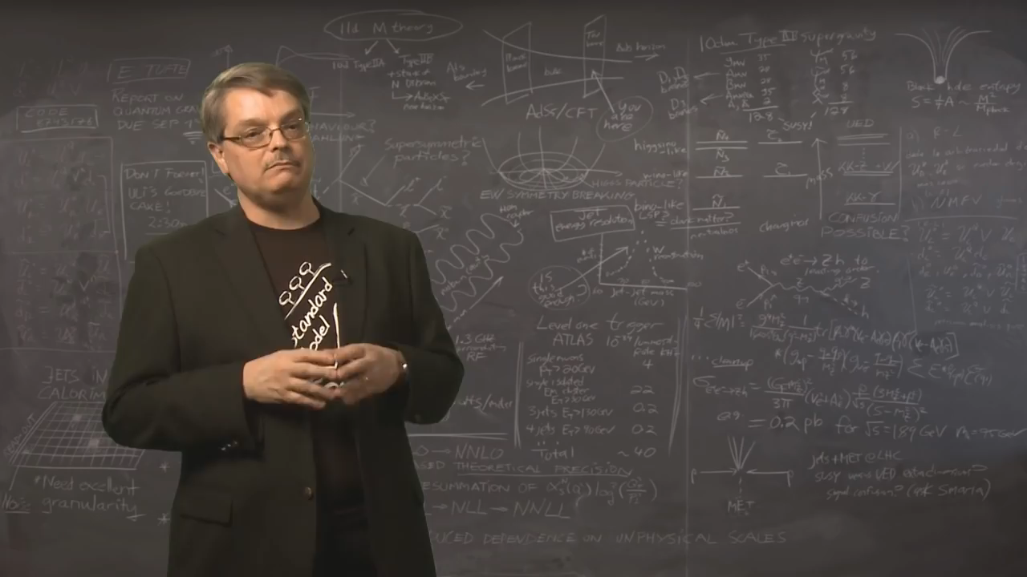
Notes:
https://youtu.be/XYcw8nV_GTs

Slide 8
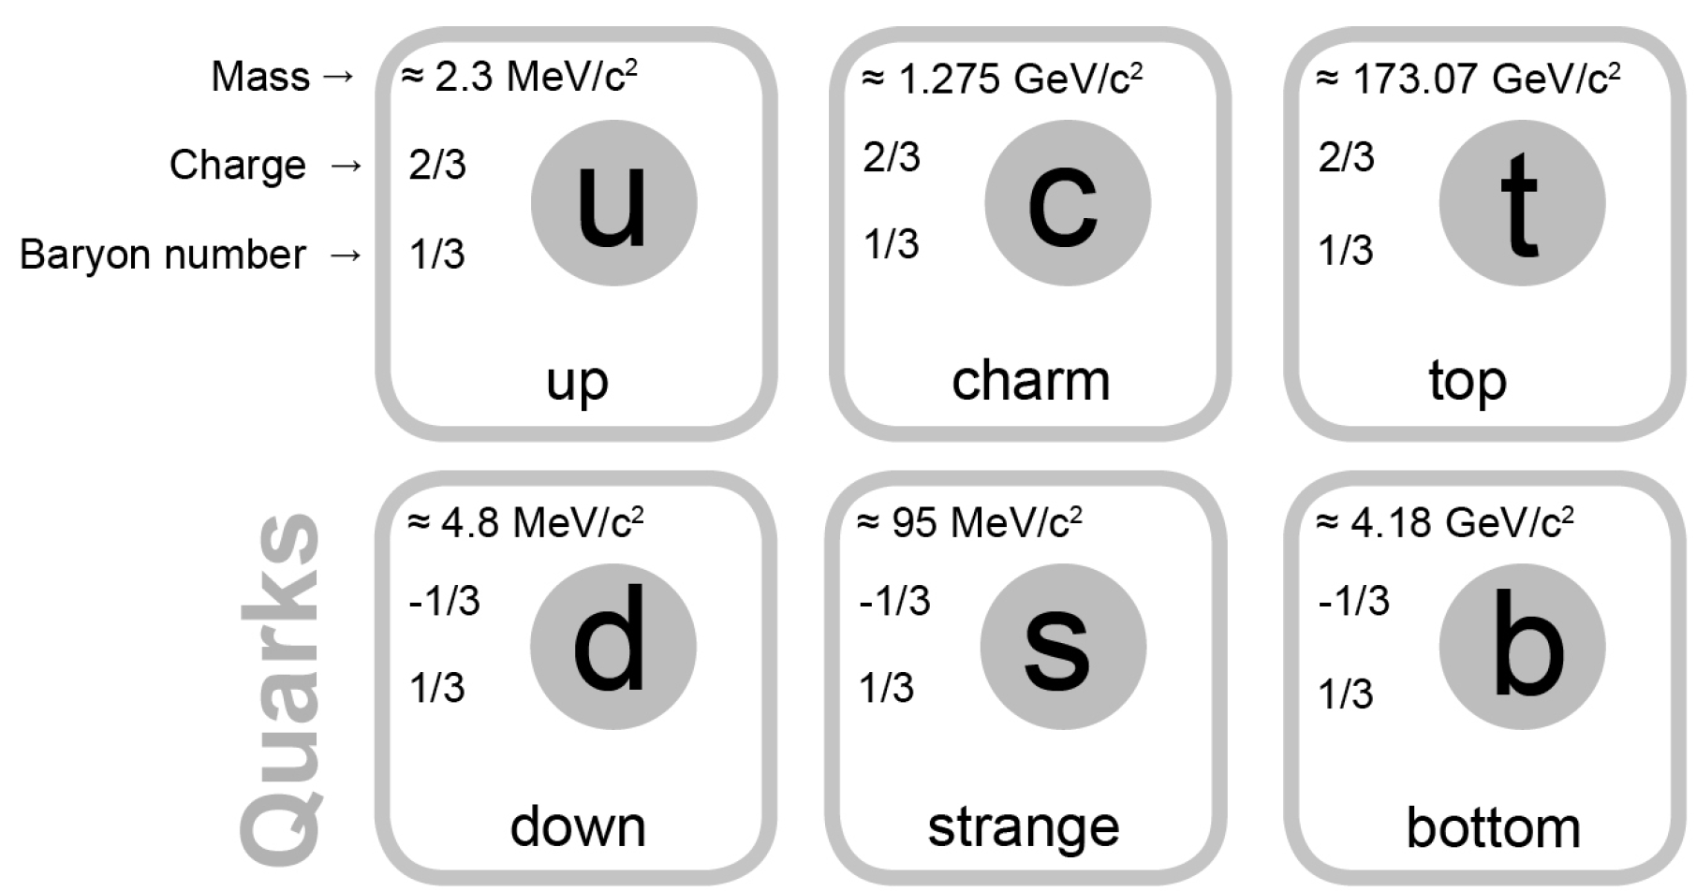
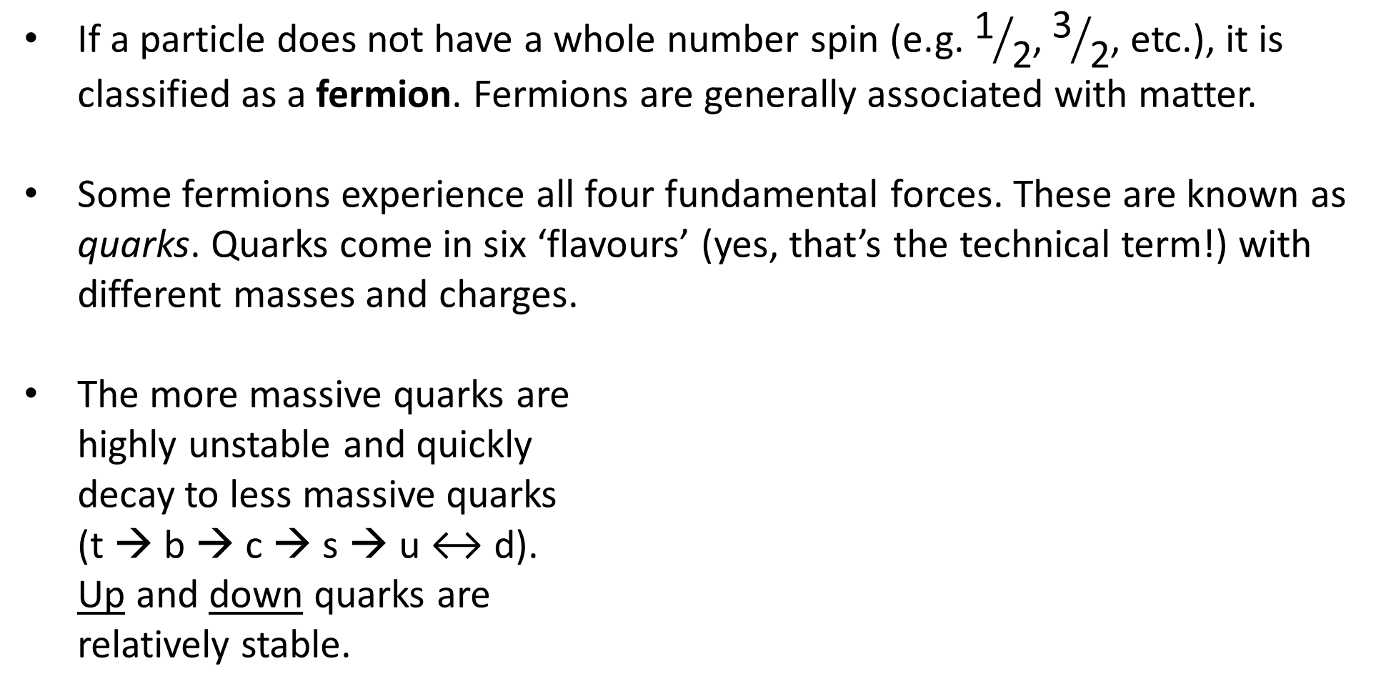
The Fermion Family: Quarks
If a particle does not have a whole number spin (e.g. ${\text{1}}/{\text{2}}$, ${\text{3}}/{\text{2}}$, etc.), it is classified as a fermion. Fermions are generally associated with matter.
Some fermions experience all four fundamental forces. These are known as quarks. Quarks come in six ‘flavours’ (yes, that’s the technical term!) with different masses and charges.
The more massive quarks are highly unstable and quickly decay to less massive quarks (t → b → c → s → u ↔ d). Up and down quarks are relatively stable.

Slide 9
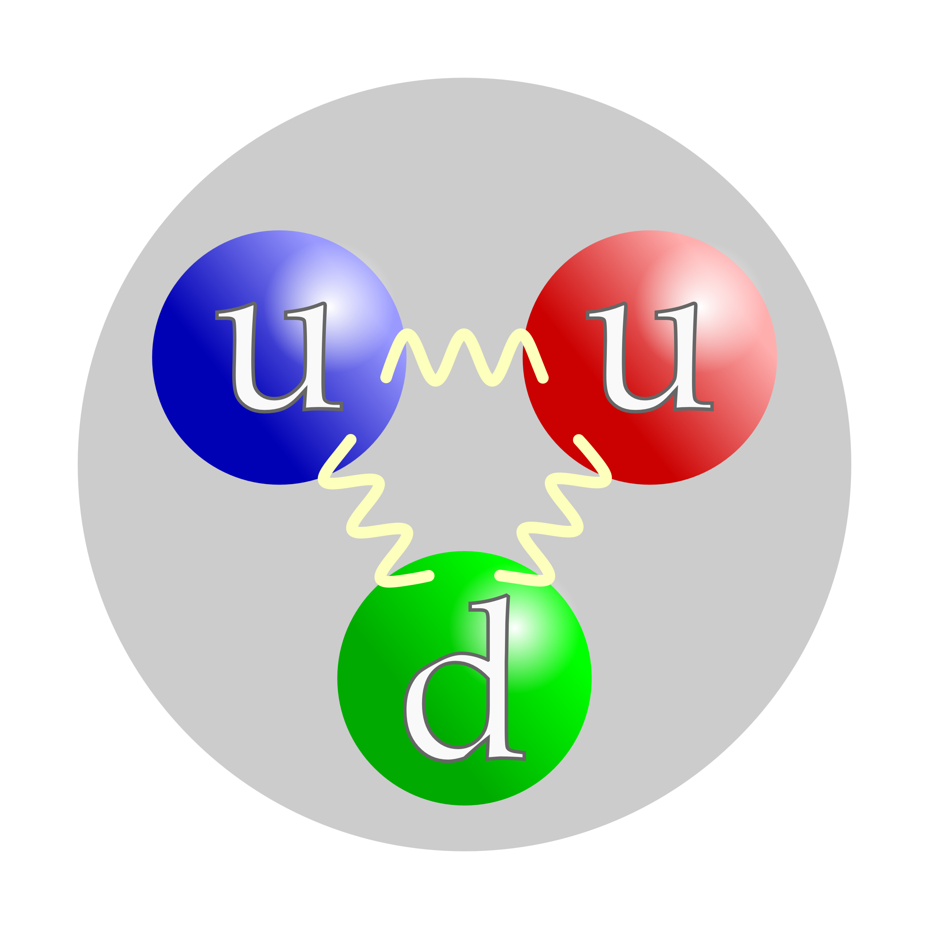
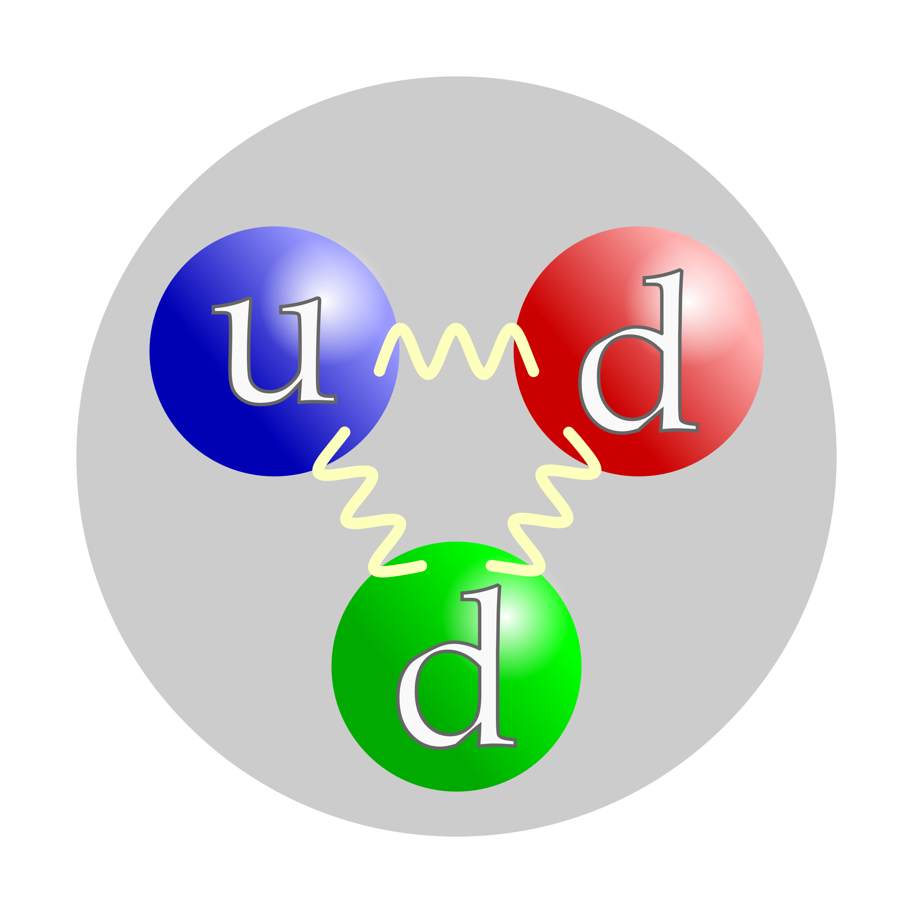
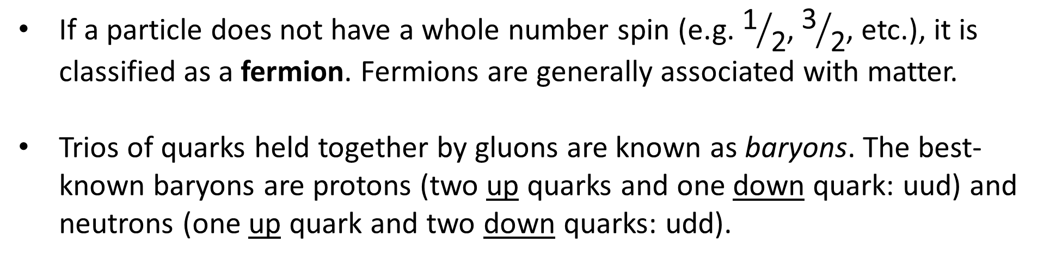
The Fermion Family: Baryons
If a particle does not have a whole number spin (e.g. ${\text{1}}/{\text{2}}$, ${\text{3}}/{\text{2}}$, etc.), it is classified as a fermion. Fermions are generally associated with matter.
Trios of quarks held together by gluons are known as baryons. The best-known baryons are protons (two up quarks and one down quark: uud) and neutrons (one up quark and two down quarks: udd).
Notes:
Technically baryons only need to have an odd number of quarks, but the existence of larger baryons is considered unlikely.

Slide 10
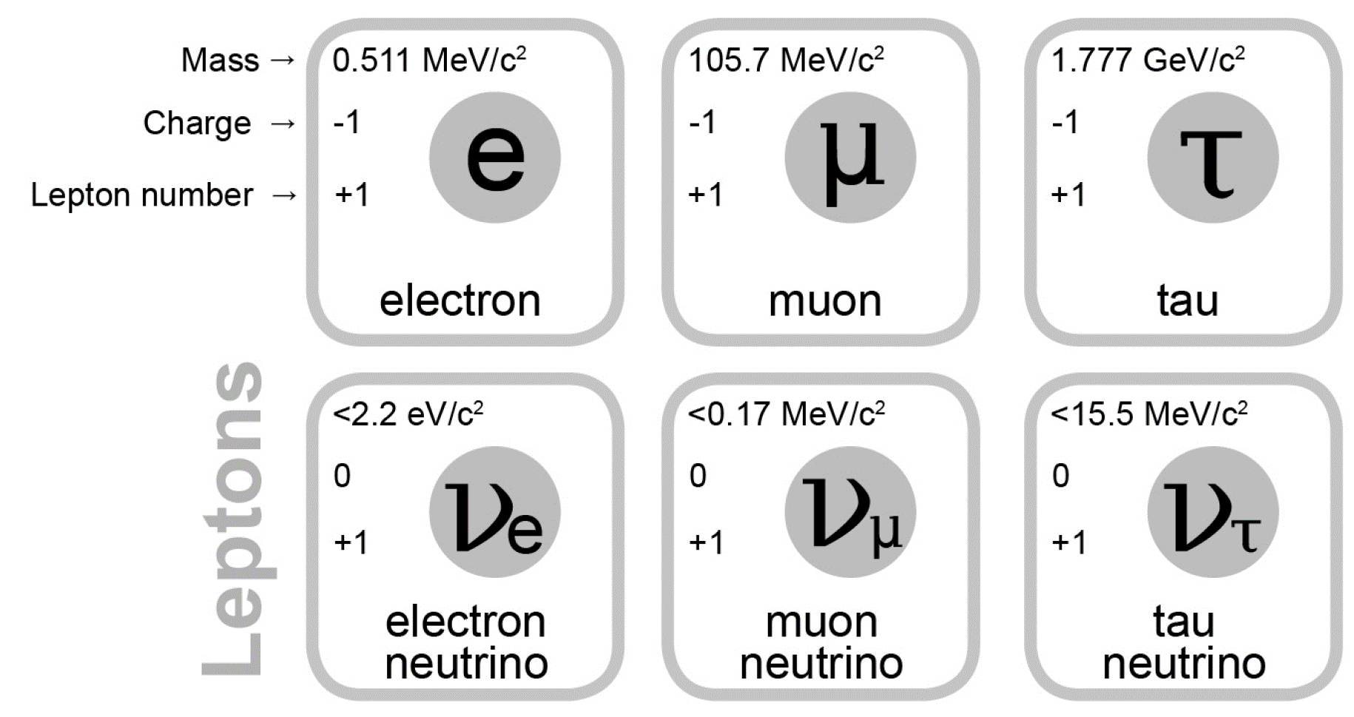
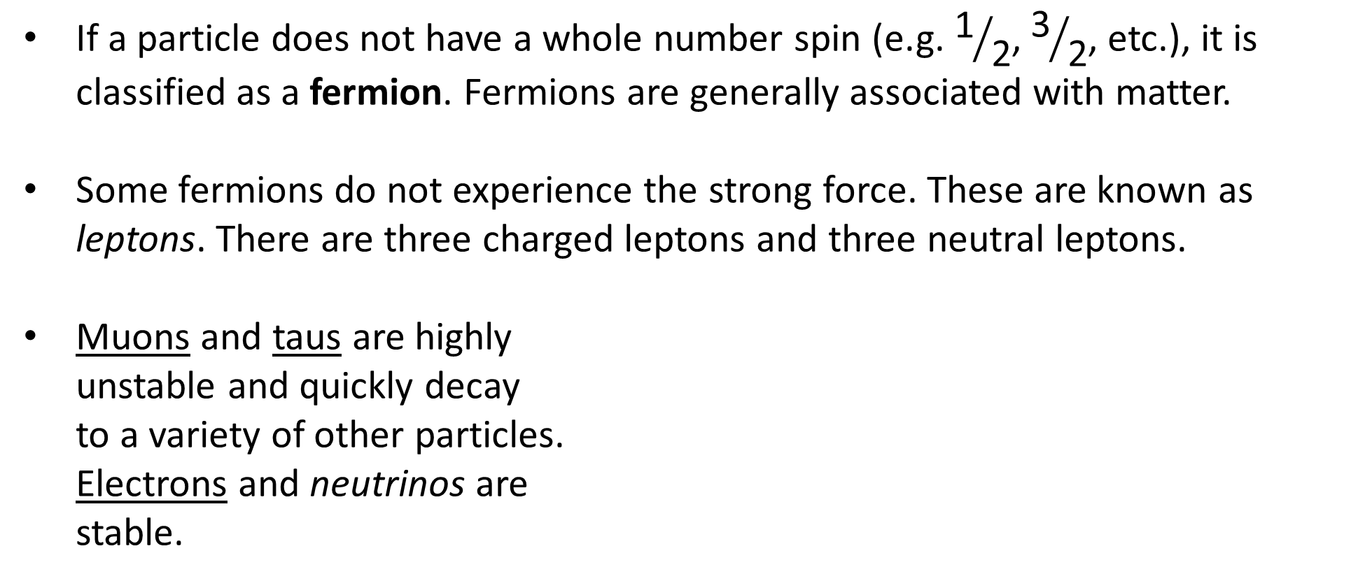
The Fermion Family: Leptons
If a particle does not have a whole number spin (e.g. ${\text{1}}/{\text{2}}$, ${\text{3}}/{\text{2}}$, etc.), it is classified as a fermion. Fermions are generally associated with matter.
Some fermions do not experience the strong force. These are known as leptons. There are three charged leptons and three neutral leptons.
Muons and taus are highly unstable and quickly decay to a variety of other particles. Electrons and neutrinos are stable.

Slide 11
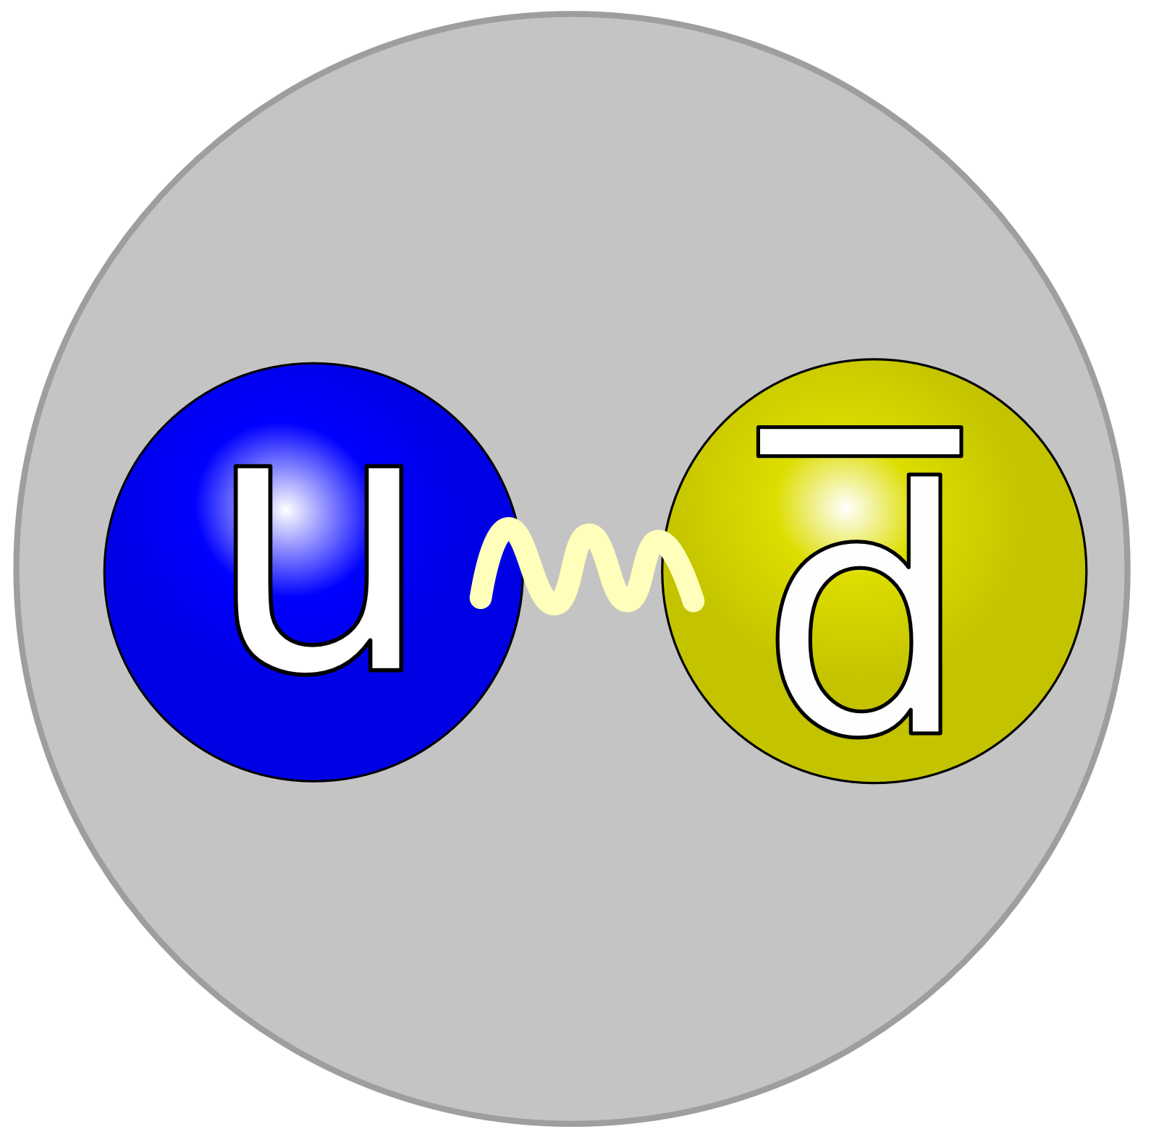
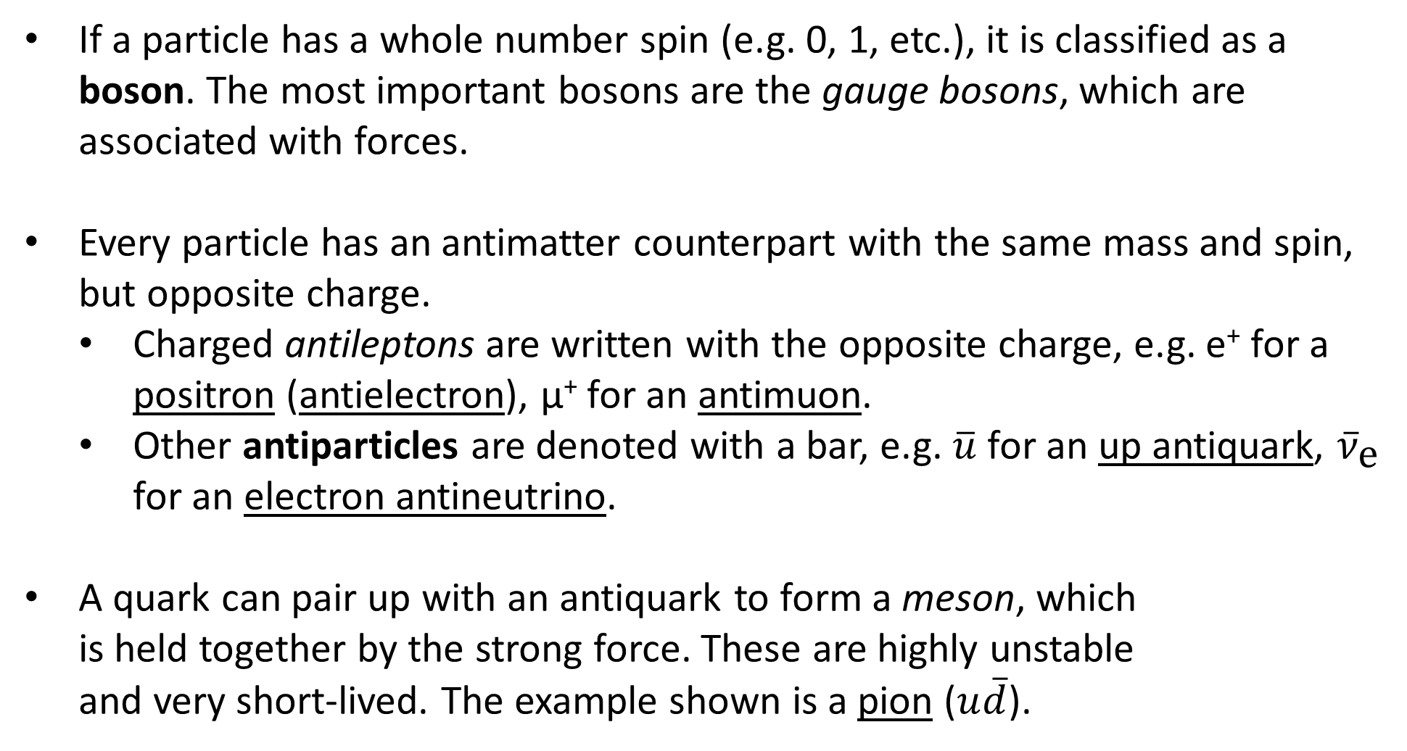
The Boson Family: Mesons
If a particle has a whole number spin (e.g. 0, 1, etc.), it is classified as a boson. The most important bosons are the gauge bosons, which are associated with forces.
Every particle has an antimatter counterpart with the same mass and spin, but opposite charge.
Charged antileptons are written with the opposite charge, e.g. e⁺ for a positron (antielectron), μ⁺ for an antimuon.
Other antiparticles are denoted with a bar, e.g. $\overline{u}$ for an up antiquark, ${\overline{ν}}_{\text{e}}$ for an electron antineutrino.
A quark can pair up with an antiquark to form a meson, which is held together by the strong force. These are highly unstable and very short-lived. The example shown is a pion ($u\overline{d}$).

Slide 12
Example #1
Hadrons are composite particles made up of two or more quarks held together by the strong force. Which two subcategories of particles are hadrons?
Notes:
Baryons and mesons

Slide 13
